Slide 1
Deconvolution of directed networks
Under the supervision of
Dr. Malay Bhattacharyya
BY –
Kishlay verma
Seema kumari
Ravi kriti

Slide 2
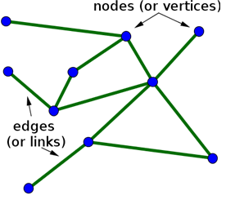
What is network?
A network is simply a collection of connected objects.
We refer to the objects as nodes or vertices, and usually draw them as points.
We refer to the connections between the nodes as edges, and usually draw them as lines between points.
In mathematics, networks are often referred to as graphs.
Networks can represent all sorts of systems in the real world. For example, one could describe the Internet as a network where the nodes are computers or other devices and the edges are physical (or wireless, even) connections between the devices.
The World Wide Web is a huge network where the pages are nodes and links are the edges.

Slide 3
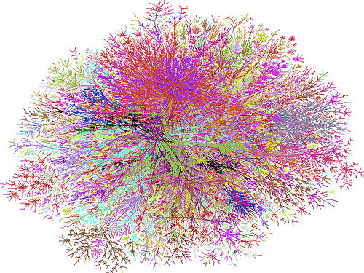
Figure 1: Network of connections between devices within the Internet.

Slide 4
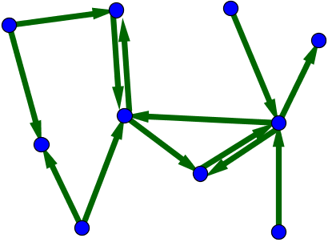
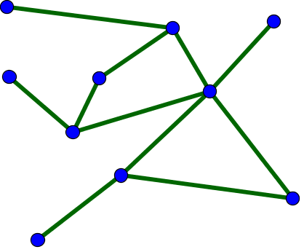
types of networks
Basically are of two types :-
Figure 2 : Directed Network Figure 3 : Undirected Network

Slide 5
What is deconvolution?
Mathematically : an algorithm-based process used to reverse the effects of convolution on recorded data.
Convolution is a mathematical way of combining two individual signals into a single signal. Deconvolution is the process of filtering a signal such that the original two signals that generated this signal can be reverted back.
Widely used in the techniques of signal processing and image processing.
Because these techniques are in turn widely used in many scientific and engineering disciplines, deconvolution finds many applications.
Some of the applications are : Seismology, optics an other imaging, radio astronomy, Fourier transform aspects

Slide 6
why network deconvolution?
Recognizing direct relationships between variables connected in a network is a pervasive problem in biological, social and information sciences as correlation-based networks contain numerous indirect relationships.
It is equally appealing to filter out the noisy relations between different nodes in a directed network.

Slide 7
What is network deconvolution?
A general method for inferring direct effects from an observed correlation matrix containing both direct and indirect effects.
Removing transitive effects from a network, thereby retrieving the noise-free original interactions.
It is a systematic approach of computing direct dependencies in a network by use of local edge weights.
Widely applicable for computing direct dependencies in network science across diverse disciplines.
Applications : distinguishing direct targets in gene expression regulatory networks; recognizing directly interacting amino-acid residues for protein structure prediction from sequence alignments; and distinguishing strong collaborations in co-authorship social networks using connectivity information alone.

Slide 8
Approaches…
Several approaches have been proposed to infer direct dependencies among variables in a network.
Partial correlations : used to characterize conditional relationships among small sets of variables.
Probabilistic approaches, such as maximum entropy models : used to identify informative network edges.
Graphical models and message-passing algorithms : to characterize direct information flows in a network.
Variations of Granger causality : to capture the dynamic relationships among variables.
Limitations : These methods are limited to relatively low-order interaction terms, or are computationally very expensive, or are designed for specific applications, thus limiting their applicability.

Slide 9
Approach…
One important and efficient approach is the combinatorial approach.
It uses the basics of graph theory, where the vertices are the nodes and the edges are the links connecting the nodes.
Initially, identify the subnetworks of smaller orders that may contribute to the transitivity in a network.
After this, remove those edges that are transitive in the chosen subnetwork, from the original network.
This algorithm uses certain theorems to remove those transitive edges.

Slide 10
some preliminaries of network theory…
A network G consists of a set of vertices V = {v1,v2,v3,…,vn} and a set of edges E = {e1,e2,e3,…,en} forming a network .
A directed network G(V,E) consists of an ordered pair of vertices (v1,v2) and changing the order of the vertices will change the direction of the edge in between the (v1,v2) vertices.
Order of network : number of vertices in the network.
Size of network : number of edges in the network.
Indegree of vertex (deg-(v)) : the number of edge incident on a vertex v.
Outdegree of vertex (deg+(v)) : the number of edges coming out of the starting vertex v.
Pendant vertex : vertex is of degree 1 or deg+(v) = 1.

Slide 11
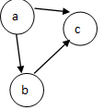
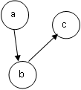
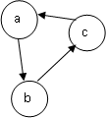
Combinatorial approach…
A network can be divided into several components or subsets of edges and vertices which results in a subnetwork.
Edges : Direct and Indirect type
Figure 1. Examples of transitivity and nontransitivity. (a) A transitive edge (a, c) formed due to the edges (a, b) and (a, c). (b) No edges are transitive. (c) No edges are transitive

Slide 12
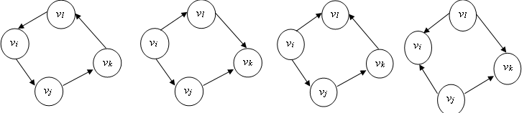
Continue…
In order to implement the algorithm for removal of transitive edges from the network, there are some important theories that should be known a priori…
A pendant vertex cannot be a part of any transitive edge.
A directed edge in a subnetwork of order 3 is transitive if and only if the outdegree of its starting vertex and indegree of its ending vertex are both 2.
No directed edge in a subnetwork of order 4 and size 4, without having a pendant vertex, is transitive.
Figure 3: The subnetworks of order 4 and size 4. None of them contain a pendant vertex and hence none of them are transitive.

Slide 13
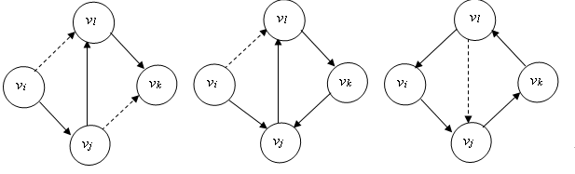
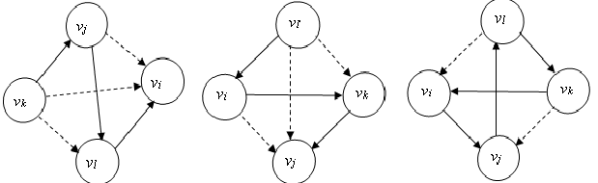
Continue…
4.A directed edge in a subnetwork of order 4 without any pendant vertex, and size 5 or 6 is transitive if and only if the outdegree of its starting vertex and indegree of its ending vertex are either 2 or 3.
Figure illustrates an example of a subnetwork of order 4 and size 5 and 6 that contains the transitive edge(dotted line).

Slide 14
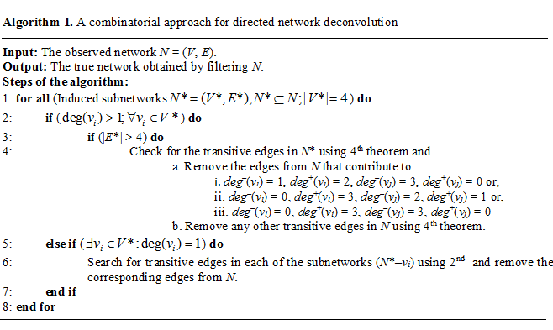
Proposed approach

Slide 15
Proposed approach
In this approach, we basically permute all the possible induced subnetworks of order 4 in the given network (step 1)
For each of them carry out a filtering approach successively (in steps 2-8).
For every chosen subnetwork, we check whether it contains any pendant vertex or not (step 2).
If this is satisfied, we again verify (step 3) whether the subnetwork N* has more than 4 edges or not, thereby considering the possibilities of size either 5 or 6 (because the order is 4).
In both the cases, we employ the 4th theory to identify the transitive edges and remove them accordingly from the observed network (step 4(a) and (b)).
Otherwise, if the subnetwork contains any pendant vertex (verified in step 5), we exclude that particular vertex from N* to derive a subnetwork of order 3.
By using 2nd theorem(step 6), we remove the transitive edges from such subnetworks.

Slide 16
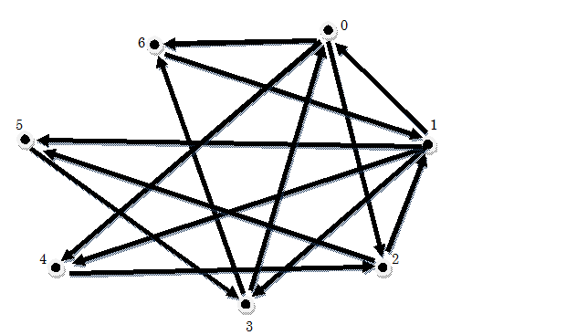
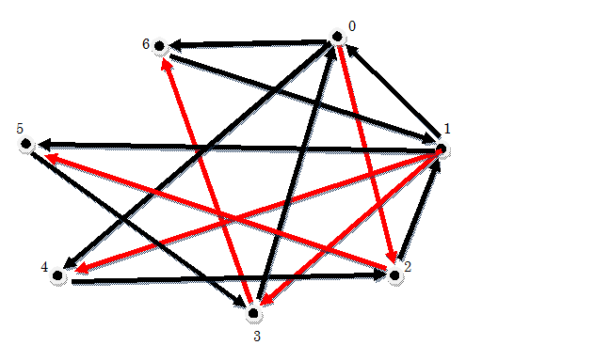
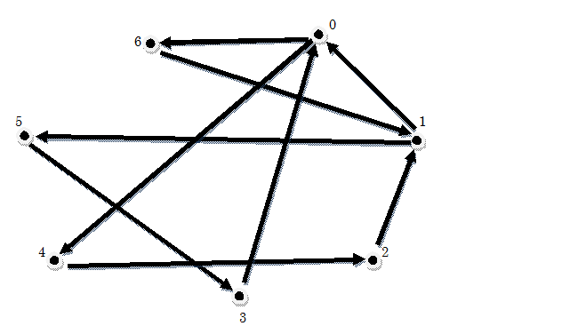
Experimental result…
For a given network model containing both direct and indirect relationships, using the different approaches discussed one can infer true relationships i.e. the direct ones from the observed network.
Figure: (i) Original graph with direct and transitive edges (ii) red lines represent the corresponding transitive edges in the graph (iii) Final graph with only direct dependencies.

Slide 17
Some examples…
Inferring Gene Regulatory Networks : DREAM5 project, to predict direct regulatory interactions between a transcription factor and its target genes.
Inferring Protein Structural Constraints : Evaluate the performance of network deconvolution in inferring contact maps for ﬁfteen tested proteins in diﬀerent folding classes with sizes ranging from 50 to 260 residues.
Inferring Weak and Strong Collaboration Ties : Application of network deconvolution on an input adjacency matrix ranks edges based on their global importance in information spread through the network. Top ranking edges have greater inﬂuence on information spread in the network, while deletion of low ranking edges have a minor eﬀect on network information ﬂows.

Slide 18
Conclusion
Provides a general framework for computing direct dependencies in a network by use of observed similarities.
Can recognize and remove spurious transitive edges due to indirect effects
Decrease edge weights that are overestimated owing to indirect relationships, and assign edge weights corresponding to direct dependencies to the remaining edges.
Can improve the quality of a broad range of observed networks that are tainted by indirect edge weights because of transitive effects.

Slide 19
references
Feizi, Soheil, et al. "Network deconvolution as a general method to distinguish direct dependencies in networks." Nature biotechnology 31.8 (2013): 726-733.
Deo, Narsingh. Graph theory with applications to engineering and computer science. PHI Learning Pvt. Ltd., 2004.
D. Marbach, et al. Wisdom of crowds for robust gene network inference. Nature Methods, 2012.
J. J. Faith, B. Hayete, J. T. Thaden, I. Mogno,J. Wierzbowski, and et al. Large-scale mapping and validation of escherichia coli transcriptional regulation from a compendium of expression profiles. PLoS Biology, 5:54–66, 2007.
P. Meyer, D. Marbach, S. Roy, and M. Kellis. Information-theoretic inference of gene networks using backward elimination, 2010

Slide 20
Thank you

